Slide 1

Cryptographic Methods for Sensitive Data Protection in a Simulated IoT Network
By: Shanysse Alexander & Brian Alvarez

Slide 2
Table of Contents
Introduction
Problem
Broader Impact
Research Questions
Purpose of Research
Case Study
Methods 1-8
Summary
References

Slide 3

Introduction
The Intent of Things (IoT) devices are interconnected and share vast amounts of data, allowing opportunities for innovation.
This connectivity also presents significant challenges to data security, particularly with sensitive information transmitted across IoT networks.

Slide 4

Problem
IoT networks are susceptible to various cyberattacks, including man-in-the-middle (MITM), denial of service (DoS), and data theft.
IoT devices often operate in distributed, resource-constrained environments, making traditional security mechanisms less effective.

Slide 5
Broader Impact
IoT devices are all around us in healthcare systems, schools, public transportation, etc.
Protecting these devices are an issue of public safety.
Unprotected IoT devices can also lead to financial loss for businesses and organizations.

Slide 6
Research Questions
What are the most effective cryptographic algorithms for securing data in resource-constrained IoT devices?
How do symmetric and asymmetric encryption methods compare in terms of performance and security in an IoT network?
What are the challenges in managing cryptographic keys in a large-scale IoT network, and what solutions can improve key management efficiency?
How does the implementation of quantum-resistant cryptography impact the security and performance of IoT networks?
What are the vulnerabilities of current IoT encryption protocols (such as SSL/TLS, IPSec, or DTLS), and how can they be mitigated?

Slide 7
Purpose of Research
The purpose researching is to investigate the effectiveness of different cryptographic methods in protecting sensitive data within a simulated IoT network.
While also discovering various encryption techniques, key management strategies, and secure communication protocols to determine the most effective solutions for IoT environments.

Slide 8

Case Study- Google Cloud Customer
Google reported that a Google Cloud customer was targeted with HTTPS DDoS attacks that peaked at 46 million rps. (June 2022)
The attack originated from more than 5,000 sources in more than 130 countries.

Slide 9
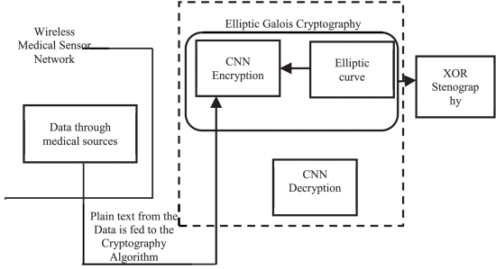
Method 1-Elliptic Galois Cryptography and Steganography Protocol
ECC, commonly known as the public key encryption technique, is based on elliptic curve theory.
The keys are generated by using the properties of elliptic curve equations instead of traditional methods.

Slide 10
Method 2- Advanced Encryption Standard (AES)
Data communication between IoT sensors and a centralized system where both parties can securely share a secret key in advance.
Fast and computationally efficient, making it suitable for IoT devices.
Distribution can be complex because the key must be securely shared between the communicating devices.

Slide 11
Method 3- Hash Function for Data Integrity (SHA- 256)
Ensures that IoT data is not tampered with by verifying the integrity of the data during transmission or storage.
Efficient verification of data integrity without needing to reveal the original content.
The only weakness with this method is that hashing alone does not provide confidentiality; it must be combined with encryption for comprehensive protection.

Slide 12
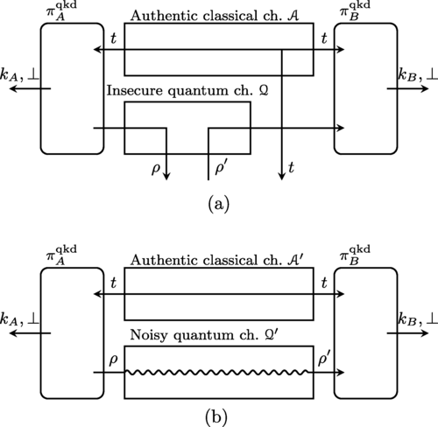
Method 4- Quantum Cryptography
Quantum cryptography leverages the principles of quantum mechanics to create secure cryptographic keys.
IoT networks that need long-term, future-proof security against quantum computers.
Unbreakable cryptographic keys, theoretically immune to future attacks by quantum computers.

Slide 13

Method 5- Asymmetric Encryption (RSA)
This code uses RSA from the pycryptodome library for encrypting and decrypting messages, typical for secure communication in IoT networks.

Slide 14

Method 6-Diffie-Hellman Key Exchange
This code demonstrates Diffie-Hellman key exchange, which is commonly used to establish shared keys in IoT networks.
Allows IoT devices to securely establish a shared key for encrypted communication.

Slide 15

Method 7- Digital Signature
This code demonstrates the use of RSA digital signatures to verify the authenticity and integrity of data transmitted between IoT devices.

Slide 16

Method 8- AES Encryption and Decryption
This code demonstrates how to encrypt and decrypt sensitive data in an IoT network using AES in CBC (Cipher Block Chaining) mode.
AES is a symmetric encryption algorithm, meaning the same key is used for both encryption and decryption.
The data is padded to ensure it's a multiple of the block size (16 bytes in AES).

Slide 17
Summary
The study examines a range of cryptographic techniques including Elliptic Curve Cryptography (ECC), Advanced Encryption Standard (AES), SHA-256 hashing, RSA, and Diffie-Hellman key exchange.
The research explores the potential of quantum cryptography as a future approach for securing communication against future threats posed by quantum computing.
An emphasis is placed on effective key management practices that are crucial for maintaining the integrity and security of cryptographic operations within IoT networks.

Slide 18
References
Portmann, C., & Renner, R. (2022). Security in quantum cryptography. Reviews of Modern Physics, 94(2). https://doi.org/10.1103/revmodphys.94.025008
Rijmen, V., Daemen, J., & National Institute of Standards and Technology. (1998). Advanced Encryption Standard. https://jima.me/wp-content/uploads/2016/05/Advanced-Encryption-Standard-Wikipedia-the-free-encyclopedia.pdf
Securing data in internet of things (IoT) using cryptography and steganography techniques. (2020, January 1). IEEE Journals & Magazine | IEEE Xplore. https://ieeexplore.ieee.org/abstract/document/8675777

